Slide 1
Chongqing University of Technology
ATAI
Advanced Technique of Artificial Intelligence
Chongqing University of Technology
CL-MoE: Enhancing Multimodal Large Language Model with Dual Momentum Mixture-of-Experts for Continual Visual Question Answering
Code：None
2025.4.10 • ChongQing
—— CVPR 2025
Reported by Peng Shan

Slide 2
Motivation
(1) Multimodal tasks require reasoning based on rich commonsense knowledge about the world.
(2) Most cases can be solved with several fixed experts, and example-specific fine-grained experts can also improve performance.
(3) We found that directly applying existing continual learning (CL) methods to MLLMs for visual-language tasks still have the problem of catastrophic forgetting.

Slide 3
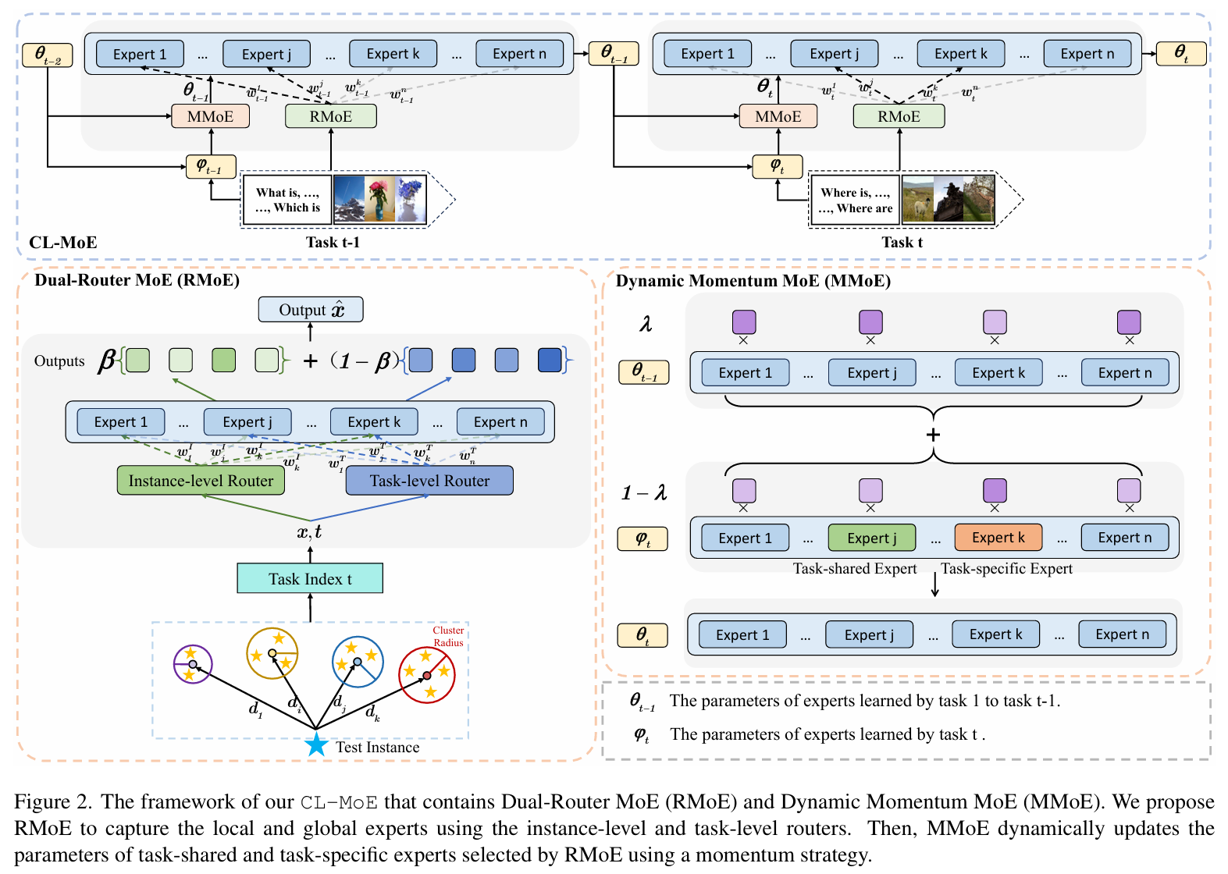
Method

Slide 4
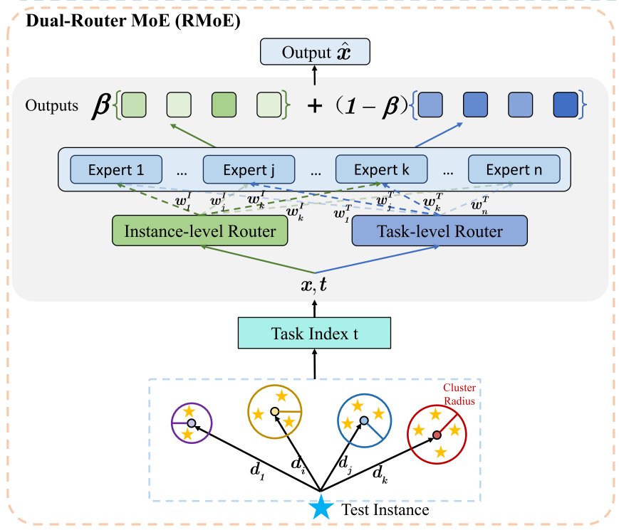
Method

Slide 5
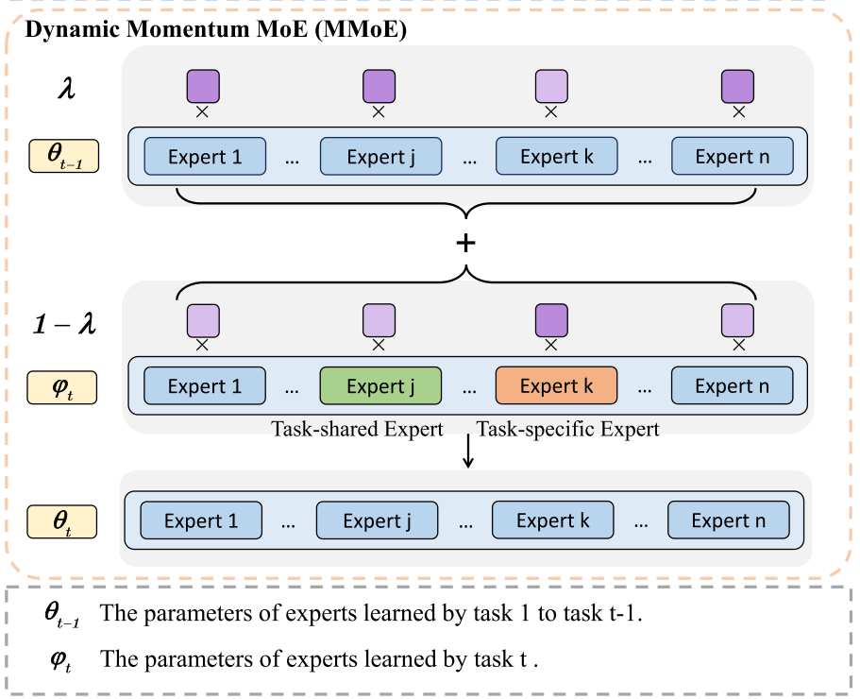
Method

Slide 6
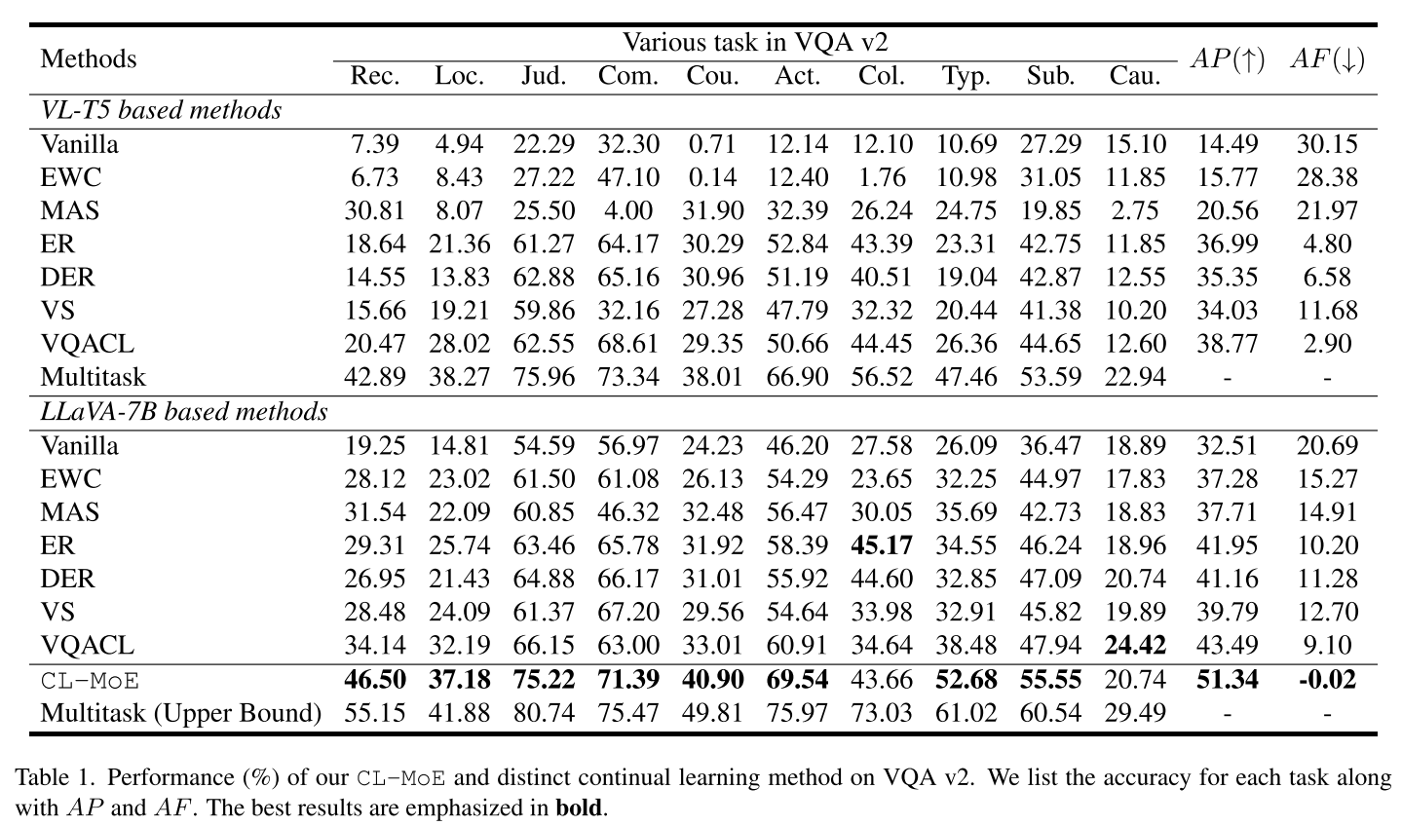
Experiments

Slide 7
Experiments

Slide 8
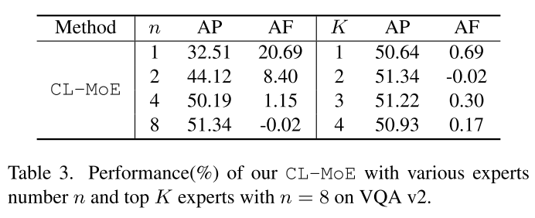
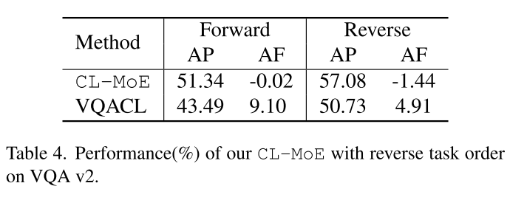
Experiments

Slide 9
Thanks!

